Slide 1

PROJECT OF PF TIC TAC TOE GAME HUMAN VS COMPUTER
PRESENTED By (JJS):
JAWERIA ASIF
JAVERIA HASSAN
HAFIZA SAMEEN NAZAR

Slide 2
TIC TAC TOE ALGORITHM
These are the following method we use in tic tac toe game.
ALGORITHM
Main method
A.I method
Mark randomly
Flip user
Draw method
Bool check win

Slide 3
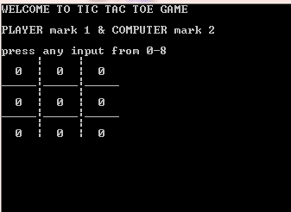
ALGORITHM
GRID of TIC TAC TOE
1 goes first (1 is referred as
HUMAN PLAYER) then 2
( is referred as
COMPUTER INTELLIGENCE).
HUMAN PLAYER puts his 1 into one of the 9 cells. When 2 goes, there are now 8 possible Board Layouts, depending on which Cell has the HUMAN PLAYER mark

Slide 4
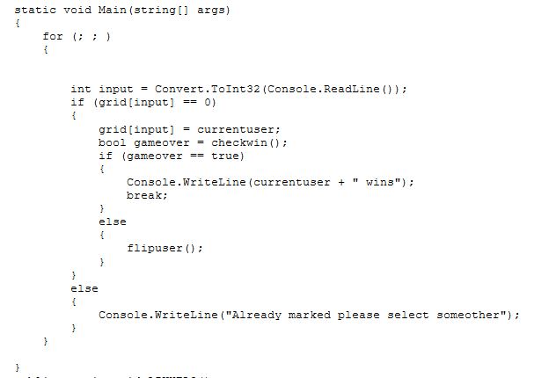
METHOD OF MAIN

Slide 5

INTRODUCTION TO A.I

Slide 6
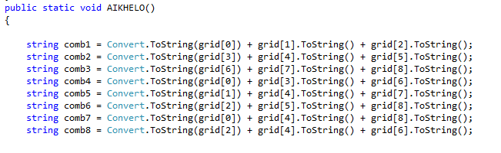
METHOD OF A.I

Slide 7
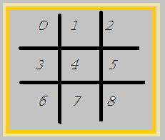
METHOD OF A.I
At first we have make eight basic possible combinations of grid such as :
Then we created the method of A.I by using if and else if and created all the possible combinations which can lead Computer intelligence towards winning point.

Slide 8
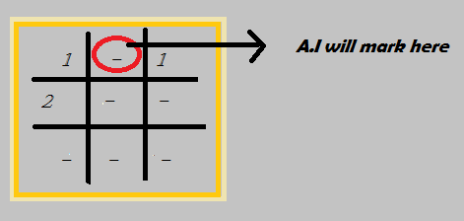
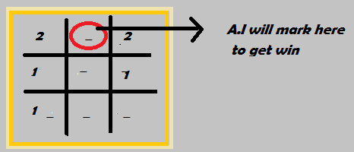
STOP AND WIN METHOD OF A.I
A.I will stop human player
From winning while mark
On the middle.
A.I will check its winning
Condition and mark at the
Position which lead A.I
towards victory.

Slide 9
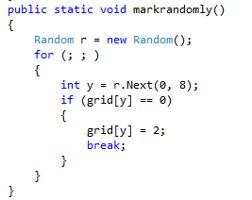
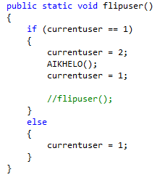
MULTIPLE METHODS
FLIP USER
MARK RANDOMLY

Slide 10
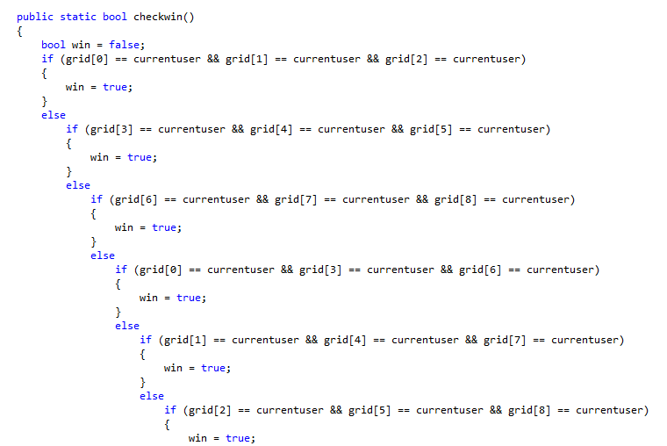
BOOL CHECK WIN METHOD

Slide 11
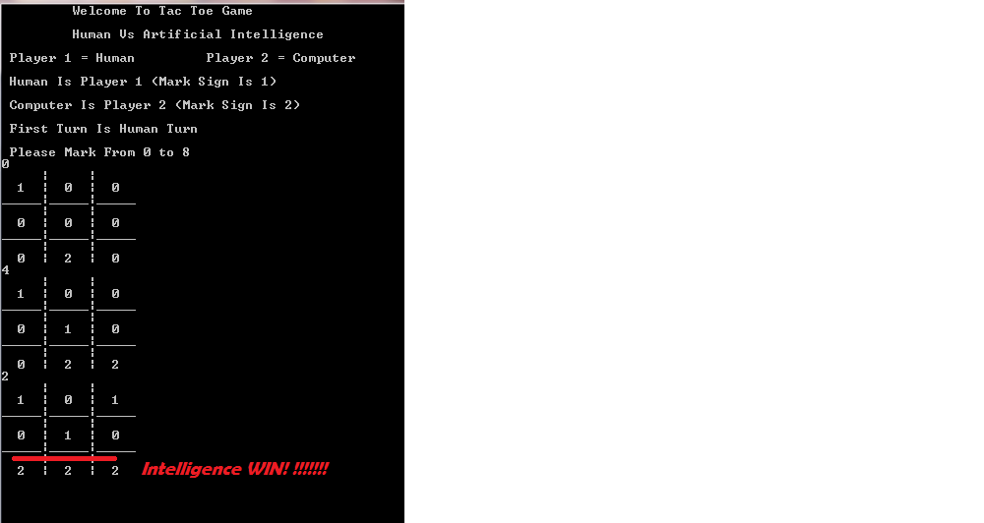
OUTPUT OF OUR PROJECT WINNING CONDITION OF A.I

Slide 12
Introduction
Tic-Tac-Toe is a very simple two player game. So only two players can play at a time. This game is also known as Noughts and Crosses or Xs and Os game. One player plays with X and the other player plays with O. In this game we have a board consisting of a 3X3 grid. The number of grids may be increased.

Slide 13
Game Rules (General)
The first player plays with "X". So you can decide who wants to go "X" and who wants go with "O".
Only one player can play at a time.
If any of the players have filled a square then the other player and the same player cannot override that square.
There are only two conditions that may be match will be draw or may be win.
The player that succeeds in placing three respective mark (X or O) in a horizontal, vertical or diagonal row wins the game.

Slide 14
CODE & OUTPUT

Slide 15
Minimax algorithm
Minimax is a recursive algorithm which is used to choose an optimal move for a player assuming that the opponent is also playing optimally. As its name suggests, its goal is to minimize the maximum loss (minimize the worst case scenario).

